Slide 1

Electronic Voting Machine Using (AT89C51)8051
Based Microcontroller (Mini Project)
By
P. Elisha Babu (23485A0428)
T. Guna Srinivas (22481A04M9)
S. Nandini (22481A04L4)
U. Srinivas (22481A04N6)
Instructor: Dr. Ch. Bala Swamy, MTech, PhD(Professor)
1

Slide 2
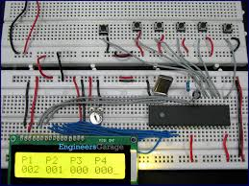
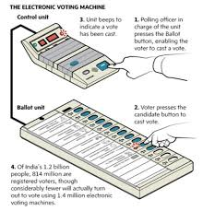
Project Overview
Objective
To automate voting systems using Microcontrollers,Switches,Displays
that minimizes the Man power,Time.
Benefits
Easy and Efficient
Saves Time
Low cost and easy installation
Control Switch

Slide 3
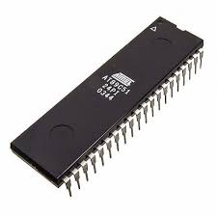
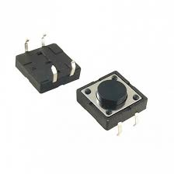
Key Components:
AT89C51(8051) Based Microcontroller
The brain of the system, which Monitors the action of switches .
8051-based Fully Static 24MHz CMOS controller with 32 I/O Lines
2 Timers/Counters, 6 Interrupts/2 Priority Levels, UART,
Three-Level Program Memory Lock
4K Bytes Flash Memory
128 Bytes On-chip RAM
S.P.S.T Push Button Switches
Used to Vote for Desired Contestants.

Slide 4
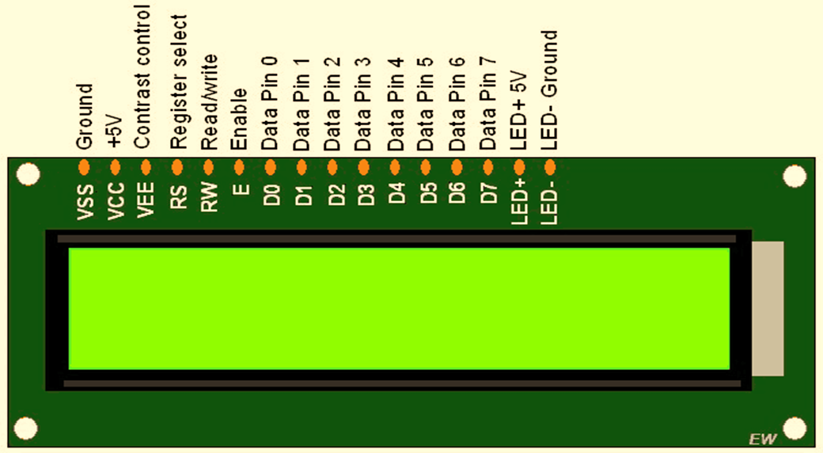
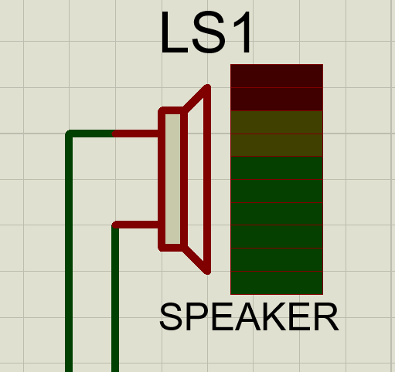
LCD Display
Which is used to display the continuous monitoring of the count of the contestants.
This L.C.D display has certain commands those are in-built to operate.
The specified operation can be performed by sending the appropriate hex code to
the data pins of this display.
Speaker
Which acts as an output device.
When ever this Speaker is Turned ON, the Voter can Vote.
It turns ON simultaneously when ever the control switch is activated.
4

Slide 5
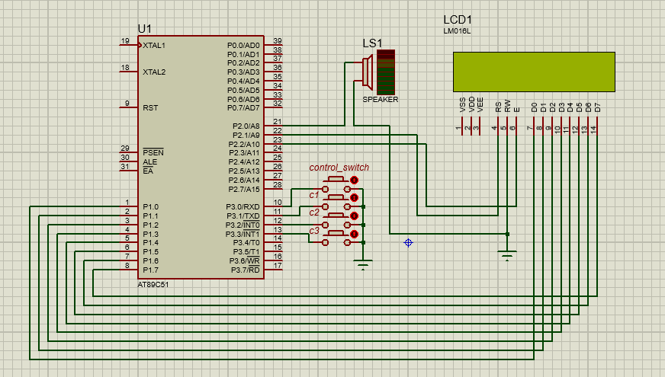
Block Diagram
5

Slide 6
Assembly Language Program:
ORG 0000H
; LCD control pins
RS EQU P2.1
EN EQU P2.2
BUZZER EQU P2.0 ; Buzzer pin
; Button Pins
CONTROL_SW EQU P3.0
C1_SW EQU P3.1
C2_SW EQU P3.2
C3_SW EQU P3.3
; Data memory locations for vote counts
C1_COUNT EQU 30H
C2_COUNT EQU 31H
C3_COUNT EQU 32H
START:
MOV C1_COUNT, #00H
MOV C2_COUNT, #00H
MOV C3_COUNT, #00H
CLR BUZZER ; Ensure buzzer off
ACALL LCD_INIT
ACALL DISPLAY_COUNTS
MAIN_LOOP:
JB CONTROL_SW, MAIN_LOOP ; Wait for control switch
ACALL DEBOUNCE
ACALL BUZZER_ON ; Play buzzer after control press
ACALL BUZZER_OFF
WAIT_FOR_VOTE:
JNB C1_SW, VOTE_C1
JNB C2_SW, VOTE_C2
JNB C3_SW, VOTE_C3
SJMP WAIT_FOR_VOTE
VOTE_C1:
INC C1_COUNT
ACALL DISPLAY_COUNTS
ACALL WAIT_RELEASE
SJMP MAIN_LOOP
VOTE_C2:
INC C2_COUNT
ACALL DISPLAY_COUNTS
ACALL WAIT_RELEASE
SJMP MAIN_LOOP
VOTE_C3:
INC C3_COUNT
ACALL DISPLAY_COUNTS
ACALL WAIT_RELEASE
SJMP MAIN_LOOP
WAIT_RELEASE:
; Wait for all buttons to be released
JB C1_SW, CHECK_C2
SJMP WAIT_RELEASE
CHECK_C2:
JB C2_SW, CHECK_C3
SJMP WAIT_RELEASE
CHECK_C3:
JB C3_SW, CHECK_CTRL
SJMP WAIT_RELEASE
CHECK_CTRL:
JB CONTROL_SW, RETURN_RELEASE
SJMP WAIT_RELEASE
RETURN_RELEASE:
ACALL DEBOUNCE
RET
BUZZER_ON:
SETB BUZZER
ACALL DEBOUNCE
RET
BUZZER_OFF:
CLR BUZZER
RET
; --- LCD routines ---
LCD_INIT:
MOV A, #38H ;8-bit mode, 2-line, 5x8 font (default)
ACALL LCD_CMD
MOV A, #0CH ;Display ON, Cursor OFF
ACALL LCD_CMD
MOV A, #06H ;Increment cursor position (default)
ACALL LCD_CMD
MOV A, #01H ;Clear display and return cursor to home position
ACALL LCD_CMD
RET
LCD_CMD:
MOV P1, A
CLR RS
SETB EN
LCD_DATA:
MOV P1, A
SETB RS
SETB EN
ACALL DELAY
CLR EN
ACALL DELAY
RET
DISPLAY_COUNTS:
MOV A, #01H ;Clear display and return cursor to home position
ACALL LCD_CMD
MOV A, #80H ; Move cursor to start position
ACALL LCD_CMD
; Display C1
MOV A, #' '
ACALL LCD_DATA
MOV A, #'C'
ACALL LCD_DATA
MOV A, #'1'
ACALL LCD_DATA
MOV A, #':'
ACALL LCD_DATA
MOV A, C1_COUNT
ACALL DISPLAY_2DIGIT
; Display C2
MOV A, #' '
ACALL LCD_DATA
MOV A, #'C'
ACALL LCD_DATA
MOV A, #'2'
ACALL LCD_DATA
MOV A, #0C0H
ACALL LCD_CMD
MOV A, #'C'
ACALL LCD_DATA
MOV A, #'3'
ACALL LCD_DATA
MOV A, #':'
ACALL LCD_DATA
MOV A, C3_COUNT
ACALL DISPLAY_2DIGIT
RET
DISPLAY_2DIGIT:
MOV B, #10
DIV AB
ADD A, #30H
ACALL LCD_DATA ; Tens place
MOV A, B
ADD A, #30H
ACALL LCD_DATA ; Units place
RET
DELAY:
MOV R6,#250
D2: DJNZ R6, D2
RET
DEBOUNCE:
MOV R5, #50
D3: MOV R4, #255
D4: DJNZ R4, D4
DJNZ R5, D3
RET
END

Slide 7
System Design: Working
& Simulation
After Burning the Hex code into the Microcontroller, This simulation Begins.
The Speaker and Control switch is connected parallel so that when the control switch is pressed, The Speaker turns ON. i.e.. Both can be turned ON simultaneously.
In background the code for LCD ON, Displaying are Running
After Speaker Activation, there is a chance for voter to vote any of the contestants c1,c2,c3.
The count will be simultaneously displayed after voting the contestants.
The rate of updating counts on display depends upon the delay which is provided on the program.

Slide 8
Advantages and Disadvantages
Advantages
Disadvantages
Simple Circuitry
High Efficiency
Programmable
Key Debouncing problems can overcome.
Power Distribution for the System must be continuous
If necessary security protocols are not satisfied, there is a
chance for tampering
9

Slide 9


Conclusion and Future Scope
Faster and Efficient
Providing Advanced Security Protocols causes No Tampering
The automatic voting machine is faster,Accurate and Efficient Method of Voting System. By providing advanced security programs to the advanced Microcontrollers causes Higher Efficient System. If it does, it has a greater scope.
10

Slide 10
Thank You
11

